Slide 1


Wildwood Ridge Metropolitan District
2026 Metro Districts Informational Meeting
January 8, 2026

Slide 2

Agenda
Call to Order
Metro District Overview
Status of Public Infrastructure
Outstanding Bonds
Unaudited Financial Statements
Questions
Adjourn

Slide 3

What is a Metro District?
A special district is a quasi-municipal corporation and political subdivision of the State of Colorado, created to provide public services that counties or municipalities cannot provide.
Districts are governed under Title 32 of the Colorado Revised Statutes, a Service Plan approved by the Governing Jurisdiction and any agreements with the Governing Jurisdiction
Powers of special districts can include:
  Streets and traffic signals
  Water and Sanitation
  Parks and Recreation
  Transportation
  Fire Protection, Ambulance, Health Services
  Safety
  Mosquito Control

Slide 4
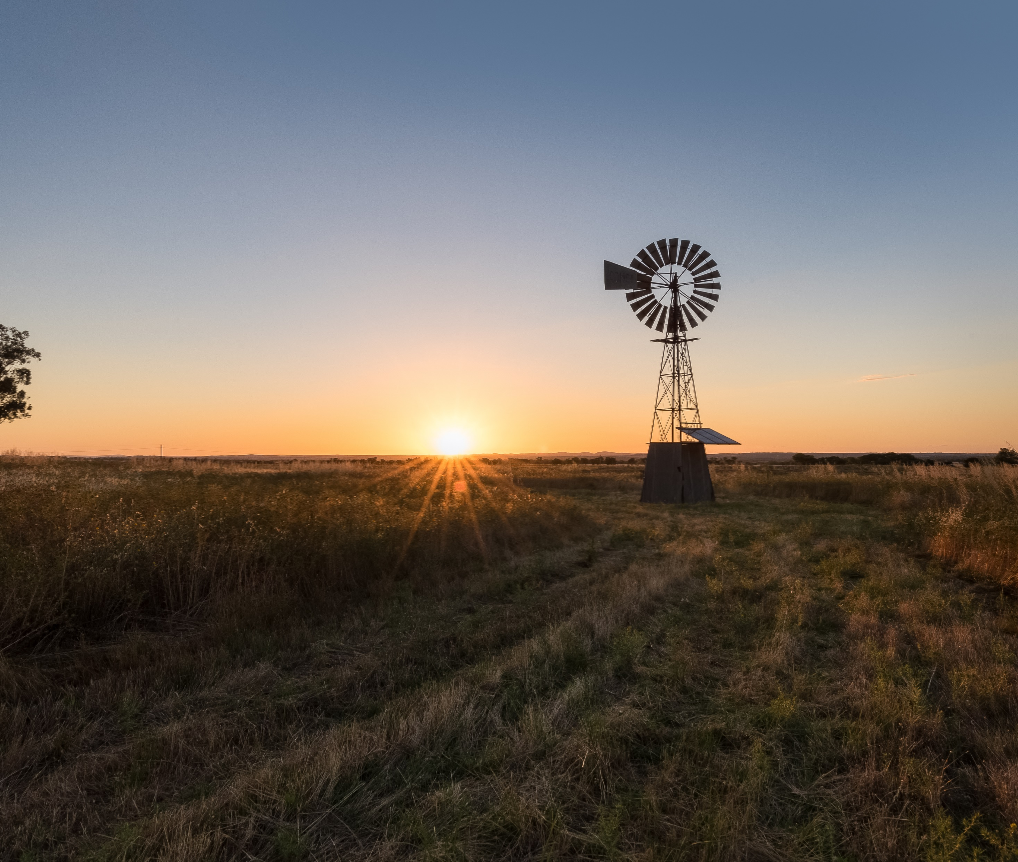
Growth Pays Its Own Way
Benefits of Metropolitan District
Fill the void - no other public entity is willing or able to fund public improvements necessary for development
Reduce cost of public improvements through access to low-cost, tax-exempt financing
Proportionate – rather than front-loading costs of public improvements on new home sales, the costs are paid via tax-deductible property mill levies over 30 years
  Homeowners pay proportionate share of use of improvements while they own property

Slide 5


Agenda Item 2)
Current Public Infrastructure
The District maintains no public infrastructure.

Slide 6
Agenda Item 3)
Current Bond and Debt Status
Bond Amount |  | Interest Rate | Issued | BALANCE AS OF 12/31/2025
Series 2010 - $285,000 |  | 8.00% | 10/2010 | $225,000.00
Maturity: Dec. 1, 2040 | BBVA | 2.84% | 11/10/2020 | 32,100,000
Operations & Maintenance Mill Levy 12.246 | Debt Service Mill Levy 37.243
How to Calculate your Property Taxes:
Market Value of your home x (times) Residential Assessment Rate (RAR) = Assessed Valuation (AV) AV x (times) Mill Levy Rate ÷ (divided by) 1,000 = Annual Property Tax EXAMPLE assuming a home value of $400,000: $400,000 x 6.25% (current RAR) = 25,000 (AV) 25,000 x 50.000 (total mill levy) = 1,250,000 ÷ 1,000 = $1,250 per year

Slide 7
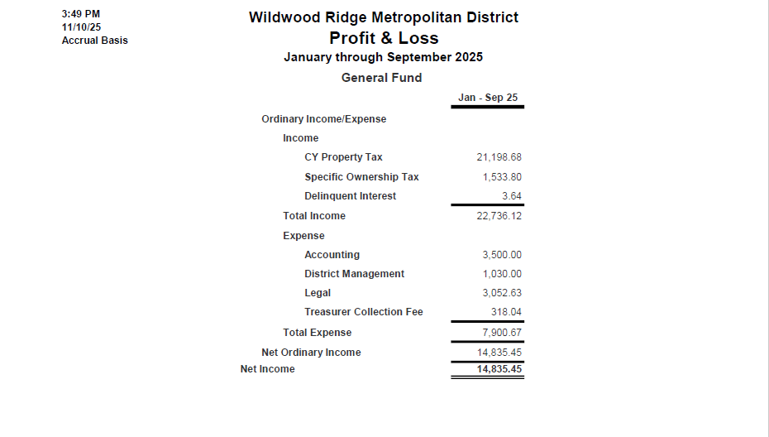


Agenda Item 4)
Unaudited Financial Statements
Profit and Loss General Fund – September 30, 2025

Slide 8
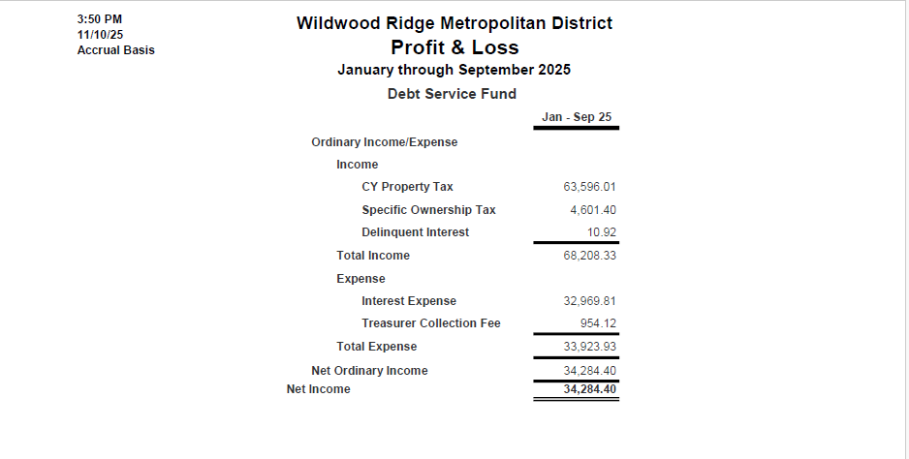
Agenda Item 4)
Unaudited Financial Statements
Profit and Loss Debt Service – September 30, 2025

Slide 9

QUESTIONS?

