Slide 1

BARNES CENNTER METROPOLITAN DISTRICT
ANNUAL TOWN HALL MEETING
December 4, 2024, at 10:00 am
Held Virtual:
https://video.cloudoffice.avaya.com/join/953789610
United States: +1 (213) 463-4500
Access Code: 953 789 610

Slide 2
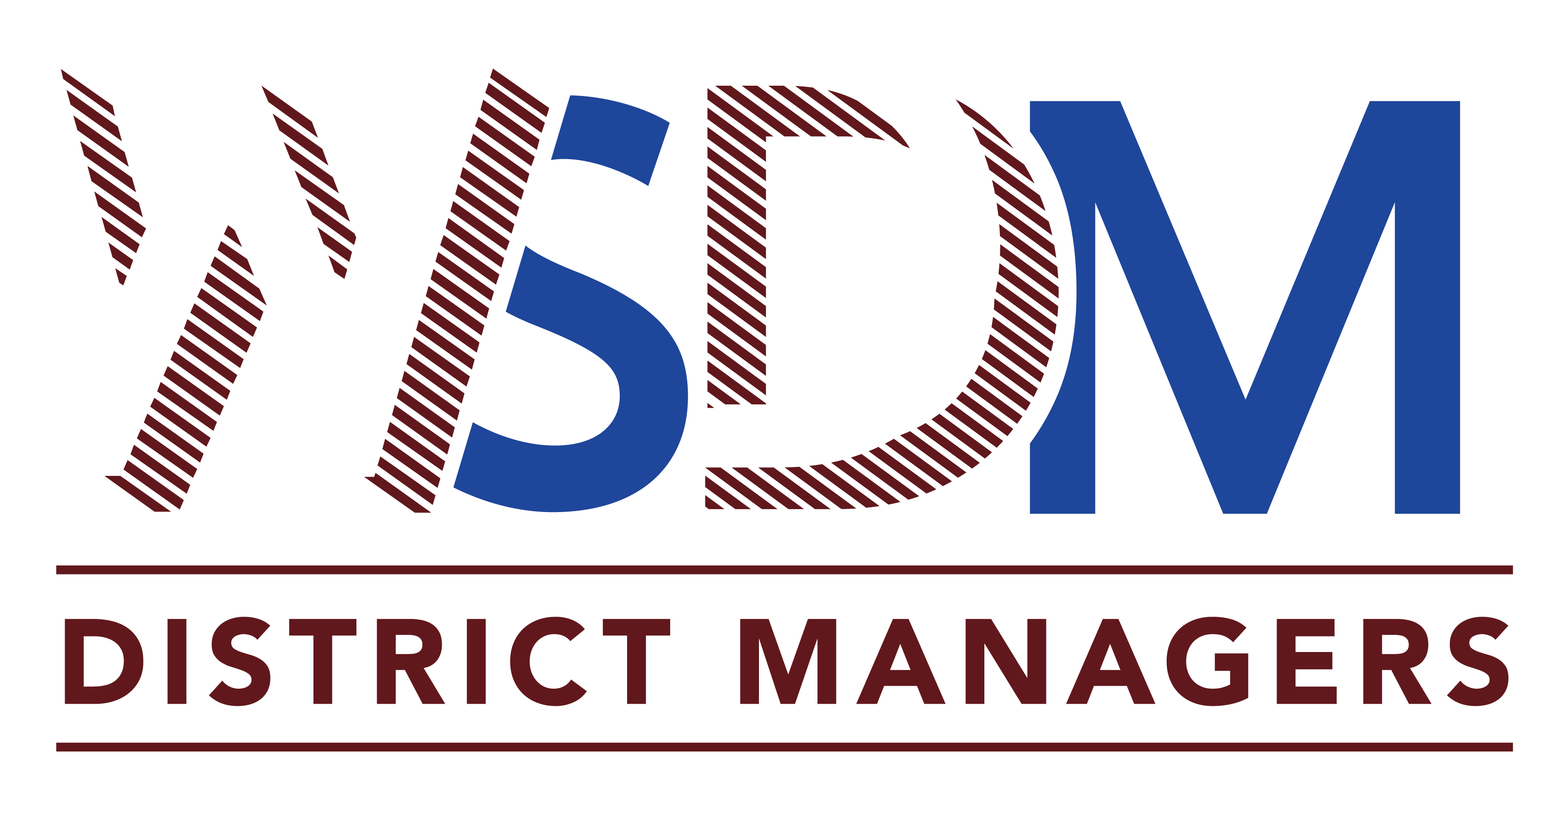
AGENDA
Call to Order
Current Public Infrastructure Projects
Current Bond Status
Review Current Year to Last Month Unaudited Financial Statements
Questions
Adjourn

Slide 3
Agenda Item 2)
Current Public Infrastructure Projects
The District currently has no infrastructure projects planned.

Slide 4
Agenda Item 3)
Current Bond and Debt Status
Bond Amounts | Lender/Trustee | Interest Rate | Issued | BALANCE AS OF 12/31/2024
2022 Bonds: $1,261,296.51 | N/A | 6.5% | 6/9/2022 | $1,261,296.51
Maturity Date: Dec. 1, 2051 |  | 4.75% | 8/26/2021
Operations & Maintenance Mill Levy 8.000 | Debt Service Mill Levy 30.00
How to Calculate your Property Taxes:
Market Value of your home X (times) Residential Assessment Rate (RAR) = Assessed Valuation (AV) AV x (times) Mill Levy Rate ÷ (divided by) 1,000 = Annual Property Tax | EXAMPLE: Home Value is $500,000 $500,000 x 6.7% (current RAR) = 33,500 (AV) 33,500 x 38.000 (current mill levy) = 1,864,007 ÷ 1,000 = $1,273/ year

Slide 5
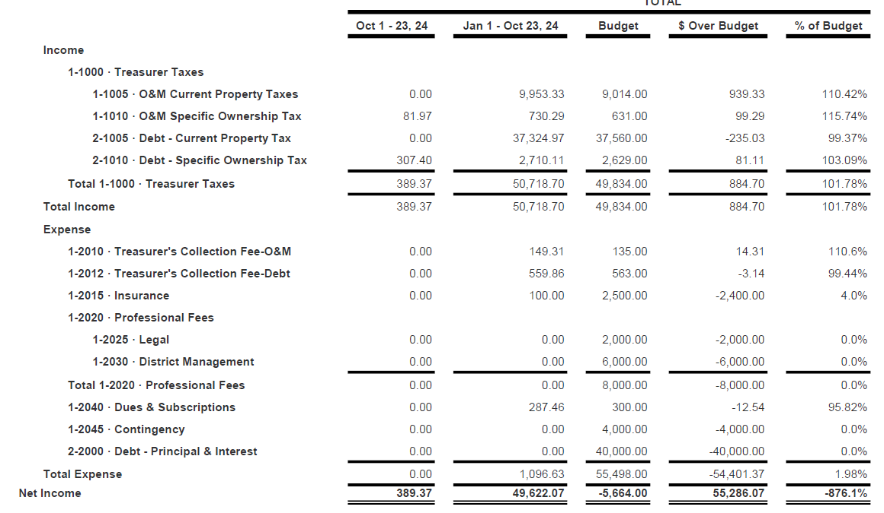



Agenda Item 4)
Unaudited Financial Statements
Profit and Loss versus 2024 Budget Comparison (part 1 of 3)

Slide 6
Questions?

